Slide 1
Ch 6. Supply, Demand, and Government Policies
Government can change the private market outcome(with price control or taxes)
Price controls
Price ceiling (=legal maximum on the price), and Price floor(=legal minimum on the price)
When the equilibrium price is above the ceiling, Price ceiling is binding, causes a ‘shortage’. Ex) Rent-control laws
When there is a shortage… rationing mechanism(long line, discrimination)
Unfair and inefficient results.
When the equilibrium price is below the floor, Price floor is binding, causes a ‘surplus’. Ex) Minimum wage laws
Economists usually oppose price ceilings and price floors.. Prices are balancing supply and demand. To help those in need, rent subsidies, wage subsidies are better than price controls.
Taxes
Government collect taxes to raise revenue for public projects.
Tax incidence: Manner in which the burden of a tax is shared among participants in a market.
Example: The Market for Pizza
Case 1: Government impose $1.5 tax on Buyers(=Buyers pay pizza tax).
A tax on buyers shifts the D curve down by the amount of the tax.
We have new equilibrium price and quantity(Buyers price and sellers price are different… Buyers have to pay $1.0 more, and sellers get $0.5 less than before… the incidence of $1.5 tax)

Slide 2
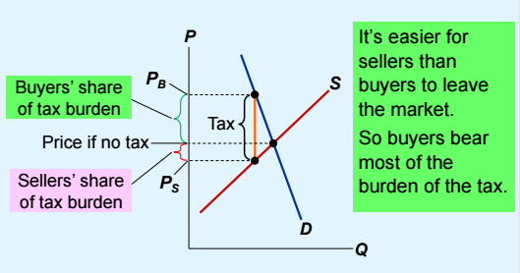
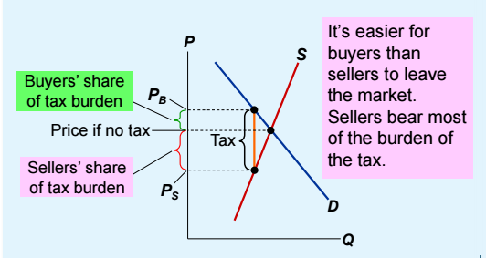
Case 2: Government impose $1.5 tax on Sellers(=sellers pay pizza tax).
A tax on sellers shifts the S curve up by the amount of the tax.
We have new equilibrium price and quantity(Buyers have to pay $1.0 more, and sellers get $0.5 less than before… the incidence of $1.5 tax)
The outcome is the same in both cases! The effects on P and Q, and the tax incidence are the same whether the tax is imposed on buyers or sellers!
Elasticity and tax incidence
Case 1: Supply is more elastic than demand
Case 2: Demand is more elastic than supply
Who pays Luxury tax?
Luxury items: Demand is quite elastic, supply is relatively in elastic
Sellers(luxury items producers) pay most of the tax!!

